Slide 1
WikiJournal of Medicine
Dr. Mikael Haggstrom
Wikimania Stockholm
@wikijmed
@wikijsci
@wikishum
Open access • Publication charge free • Public peer review
Notes:
Approx 10 min

Slide 2
Outline
Wikipedia background
WikiJournal concepts and features
Sister project proposal

Slide 3
Wikipedia Background
How medical Wikipedia interacts with the world

Slide 4
Wikipedia
A free encyclopaedia that anyone can edit
The largest and most popular general reference work on the Internet
38 million articles
250 languages
18 billion views per year
5th most visited website
Articles in English

Slide 5
Why does Wikipedia matter?
The general public trust it
Giles J (2005). "Internet encyclopedias go head to head". Nature
Lucassen T, Schraagen JM (2010) Trust in Wikipedia: how users trust information from an unknown source. Proceedings of the 4th workshop on Information credibility
Doctors use it (50% - 70%)
Heilman JM, West AG (2015) “Wikipedia and Medicine: Quantifying Readership, Editors, and the Significance of Natural Language.” J Med Internet Res
Students use it (>95%)
Allahwala UK et al. (2013) “Wikipedia use amongst medical students–New insights into the digital revolution” Medical teacher
Educators use it (>85%)
Purcell K et al. (2013) “How teachers are using technology at home and in their classrooms” Pew Research Center
Lawmakers use it
Peoples LF (2009) "Citation of Wikipedia in Judicial Opinions, The." Yale JL & Tech

Slide 6
Wikipedia’s limitations
Inconsistent quality and coverage
Clauson, K. A; Polen, H. H; Boulos, M. N K.; Dzenowagis, J. H (18 November 2008). "Scope, Completeness, and Accuracy of Drug Information in Wikipedia". Annals of Pharmacotherapy 42 (12): 1814–1821. doi:10.1345/aph.1L474. PMID 19017825.
Changes are reviewed, but not systematically
Clinicians/academics/ researchers often want credit for their work
More than a mention in the “history” tab
A shortage of images
Can not simply use any image on the internet due to copyright
Cannot incorporate original research
Notes:
BUT has its limitations

Slide 7
Academic journals’ limitations
Maintenance costs, subscription costs, advertising
Most are paywalled to readers
Non-paywalled journals charge authors (article processing charge)
… Some charge both authors and readers!
Copyright of images
Limited readership (size and demographics)
Rigid, unchanging articles become out of date

Slide 8
How does Wiki.J.Med complement Wikipedia?
Published in a standard academic journal format
Compliant with international journal guidelines (ICMJE, COPE, & BOAI)
Indexed (G-scholar, DOAJ, DOI, CrossRef, ISSN, informit, ScienceOpen)
Associates (ReimagineReview, )
Familiar format to researchers and health professionals
Permanent, citable “version of record”
Externally peer reviewed (publicly accessible)
Authors are credited for their work
Ethics, guidelines and processes externally audited
Suitable material is incorporated into the encyclopaedia to be dynamic living version with maximum reach and impact

Slide 9
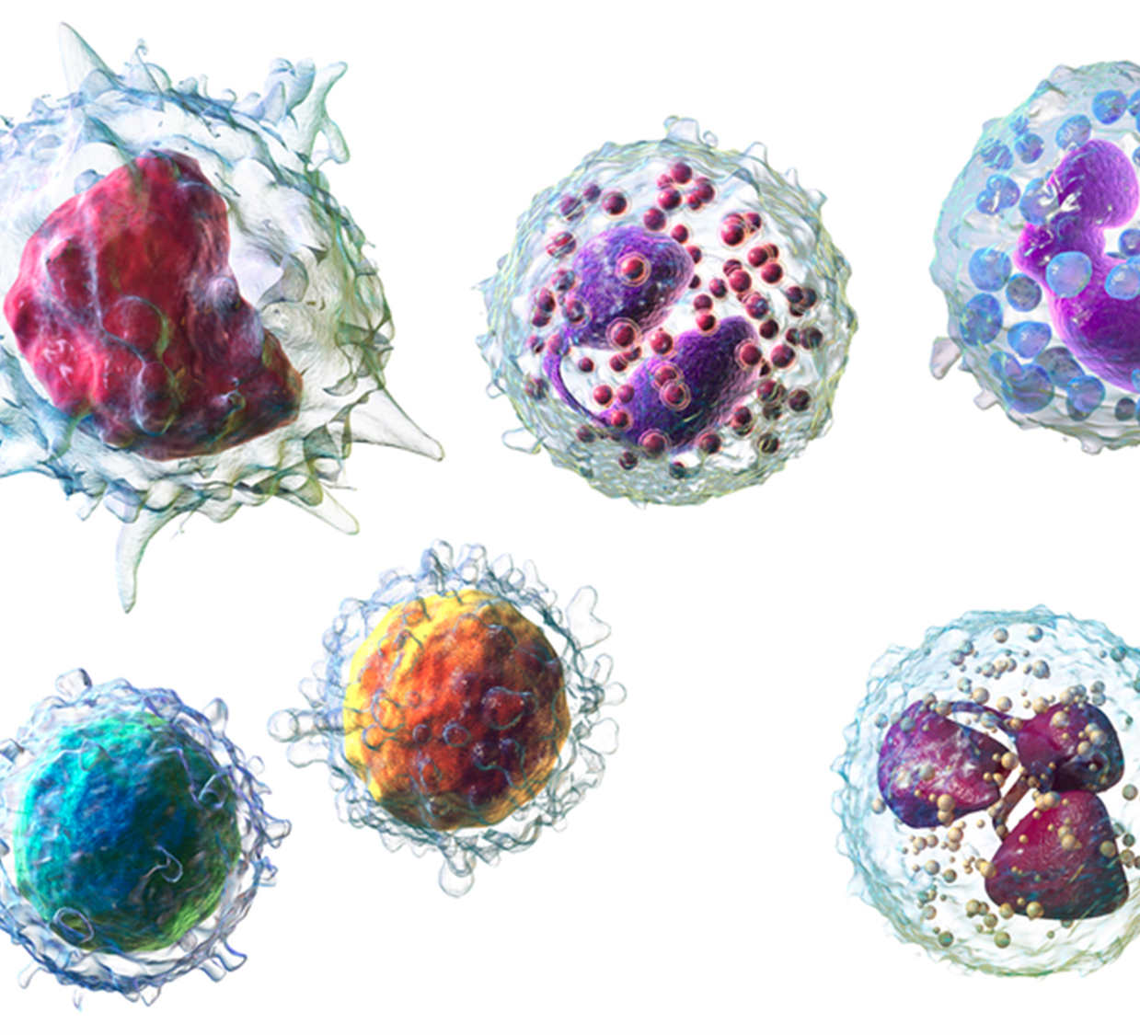
WikiJournal concepts and features
A complementary system for high-quality content

Slide 10
Notes:
WikiJMed was first, not expanded to group of three

Slide 11
Key features
Open Access
All published articles are openly accessible under a free Creative Commons license
Free to publish
WJM is a fully non-profit journal run by volunteer editors so has no publication charges of any kind
Public peer-review
All article peer reviews are published and publicly accessible
Wikipedia-integrated
Appropriate material is integrated into Wikipedia for added reach and exposure
Notes:
Articles are immediately open access in the journal
neither the reader nor the author pays anything

Slide 12
Publication formats
Research
Review
Original research
Original research on medical, biomedical, or medical humanities topic can be submitted. Such papers follow the standard format of Introduction, Method, Results, Discussion. Supplementary data set publication is encouraged.
Case studies
The journal publishes medical case studies, typically of a patient, but also of significant events, decisions, projects, or policies.
Focused
These reviews focus on a specific topic in detail, summarising and synthesising published works. Sections of these may be integrated in relevant, specialist Wikipedia articles.
Encyclopaedic
These broad summaries cover an entire topic and are written in an encyclopaedic tone. They are commonly uploaded to Wikipedia after publication. They can also be re-writes, expansions or improvements of existing important Wikipedia articles.
Image
These are short reviews centred around a key figure. This can be medical photography, imaging, a diagram, schematic, video or animation. The article gives relevant background, explains the image and acts as an extended figure legend.

Slide 13
Case studies – improving Wikipedia
Full review articles
Article sections
Existing high-quality Wikipedia article updated and submitted
Hippocampus
Wikipedia article previously existing but flawed/outdated
Lysine
Wikipedia article previously completely absent/stub
Anthracyclines
Section of Wikipedia article warranted own page
Gene structure
Wikipedia articles previously lacked images
Cell disassembly during apoptosis

Slide 14
Case studies – beyond Wikipedia
Teaching resource used in Wikiversity
Acute gastrointestinal bleeding from a chronic cause: a teaching case report
Teaching resource used outside of Wikiversity
A card game for Bell's theorem and its loopholes
Image gallery in Commons and used throughout Wikimedia
Medical Gallery of Blausen Medical
Stand-alone research article
Vitamin D as an adjunct for acute community-acquired pneumonia among infants and children: systematic review and meta-analysis
Possibly also
Wikibooks?
Wikidata?

Slide 15
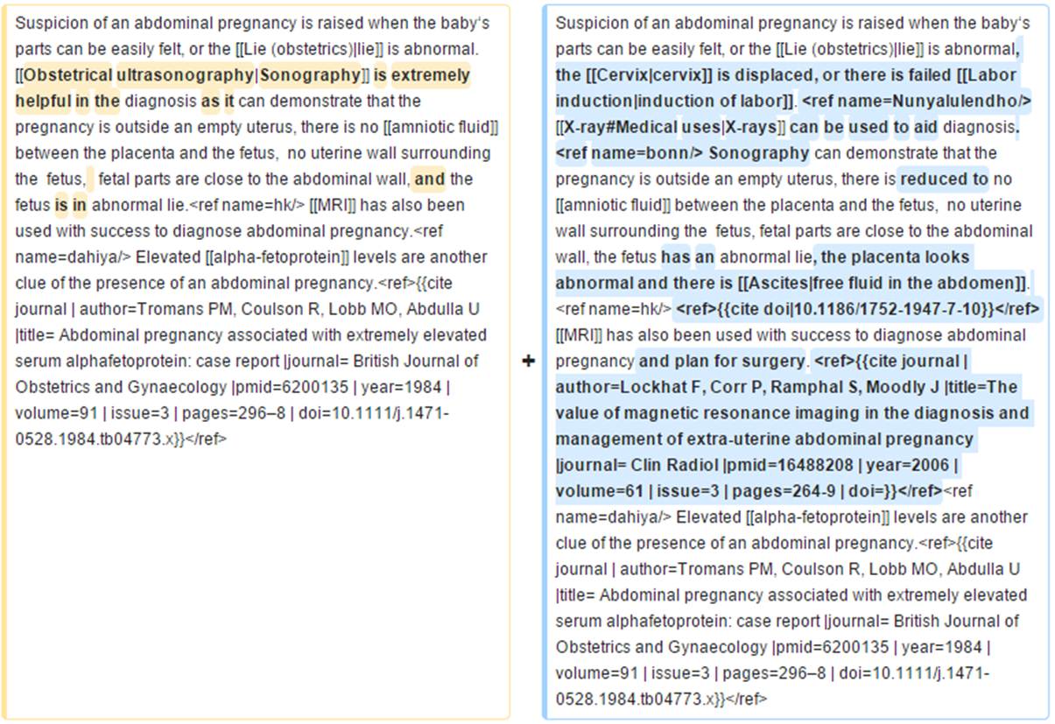
Before
After
Text used to expand Wikipedia articles

Slide 16
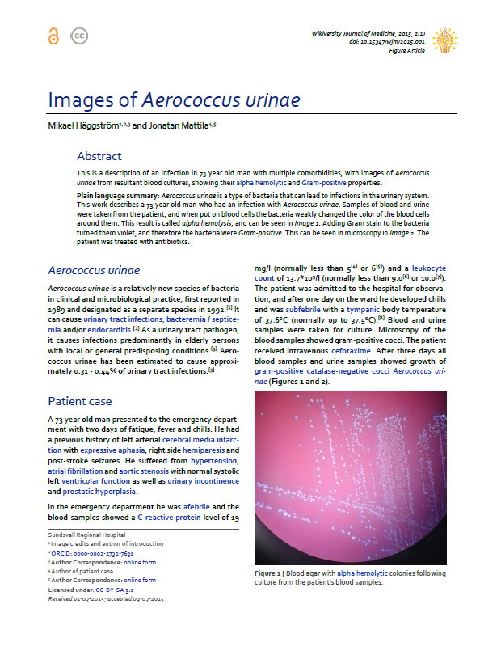
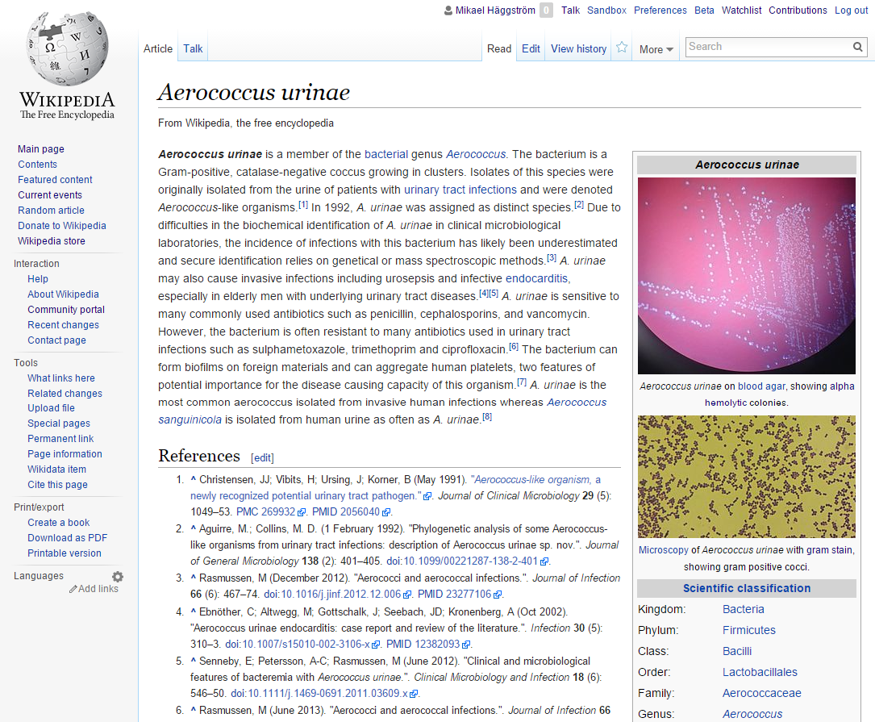
Images are stored in Wikimedia Commons, and can be used across sister projects.

Slide 17
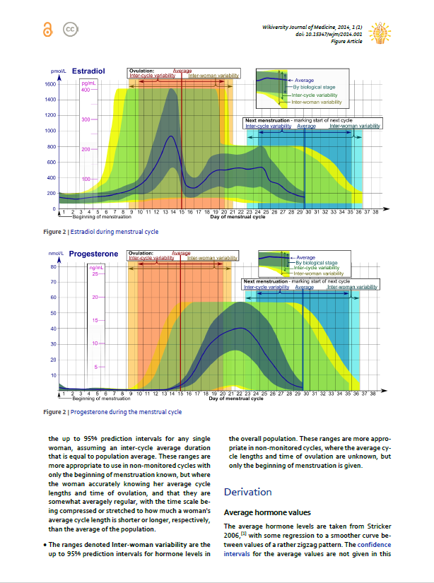
Images from this one paper appear in articles with a total of 255,000 readers per month.
Wikipedia articles where media are used | View count (Feb 2015)
Estrogen | 53793
Estradiol | 27055
Menstrual cycle | 53209
Ovulation | 15584
Reference ranges for blood tests | 23898
Progesteron | 34680
Follicle-stimulating hormone | 22883
Luteinising hormone | 23706

Slide 18
Publishing flow (Journal first)
Publication
PDF
Citable
Stable
Indexed
Version of record
Preprint
server
Public
peer review
HTML
doi
Highly accessed
Broad readership
Editable and updatable
Wikipedia-integration
WikiJSci Editorial Board. (2018). The aims and scope of WikiJournal of Science. WikiJSci 1(1)

Slide 19
Publishing flow (Wikipedia first)
Preprint server
Publication
PDF
Citable
Stable
Indexed
Version of record
Public
peer review
HTML
doi
Highly accessed
Broad readership
Editable and updatable
Wikipedia as preprint
Wikipedia-integration
WikiJSci Editorial Board. (2018). The aims and scope of WikiJournal of Science. WikiJSci 1(1)

Slide 20
Publishing flow (Versioning)
Preprint server
Publication
PDF
Citable
Stable
Indexed
Version of record
Public
peer review
HTML
doi
Highly accessed
Broad readership
Editable and updatable
Versioning
Wikipedia as preprint
Wikipedia-integration
WikiJSci Editorial Board. (2018). The aims and scope of WikiJournal of Science. WikiJSci 1(1)

Slide 21
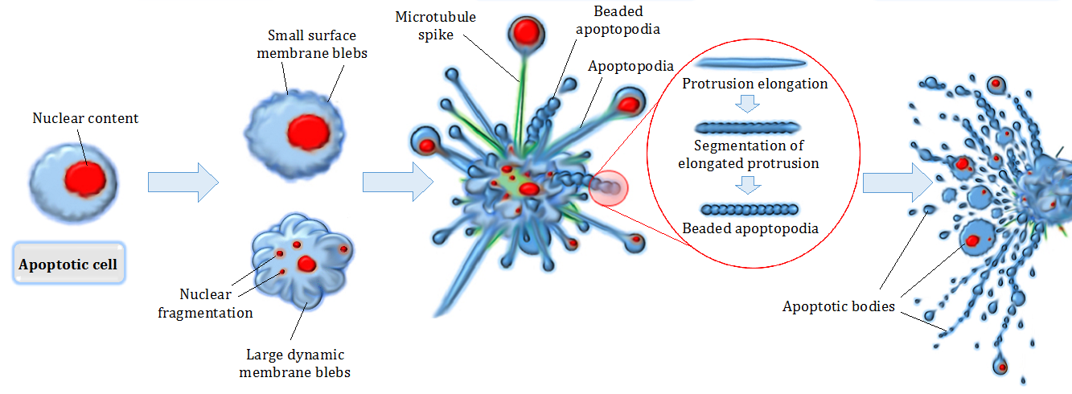
Who can submit articles?
Anyone can submit
All authors treated equally
Only content assessed
Ideal for medical and research professionals aiming to
Achieve maximum outreach, exposure, and impact
Be rewarded for expert input to open access projects
Contribute to the world’s most read encyclopaedia
Gain experience as corresponding author

Slide 22
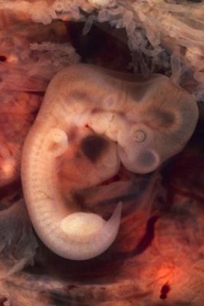
Who can peer review articles?
Anyone can give review
Pre- or post-publication
External experts invited to review (at least 2 required)
Have expertise in the relevant medical field, and be willing to provide relevant credentials if requested.
Be willing to disclose any potential conflicts of interests
Not be editorial board members of this journal
Anonymity optional

Slide 23
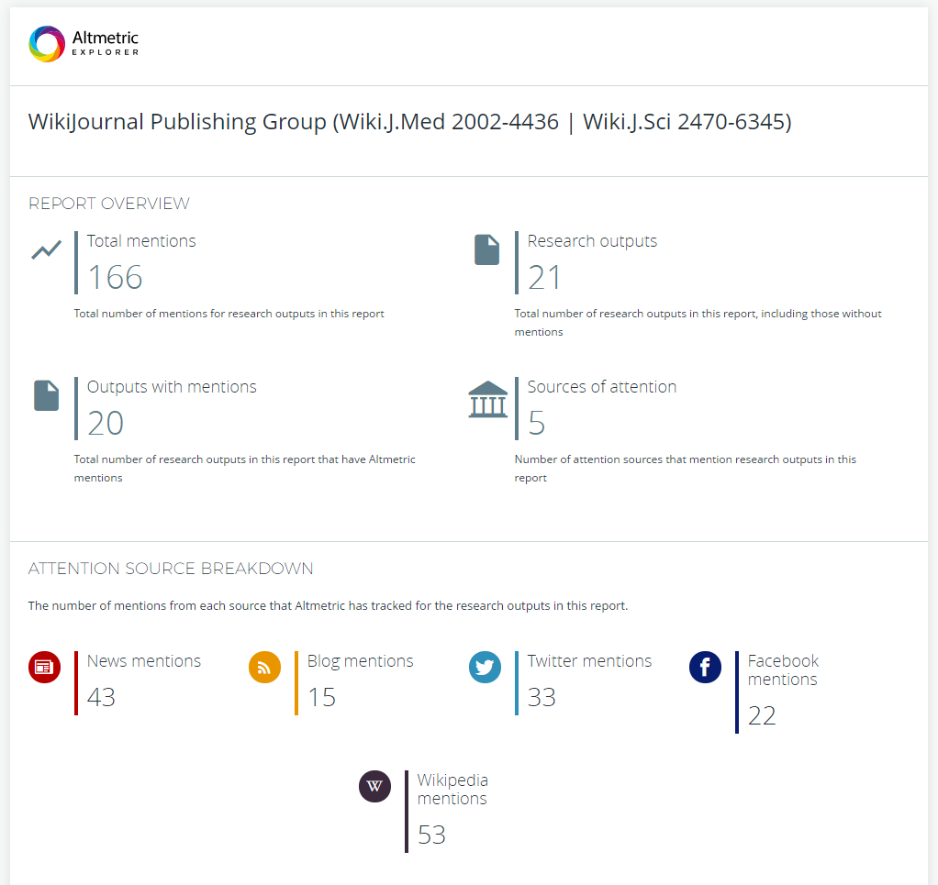
High alt-impact

Slide 24
The Editorial Board
Fully volunteer
3 MD doctors
1 PsyD doctors
6 PhD doctors
4 Student
4
5
3
1
0
1

Slide 25
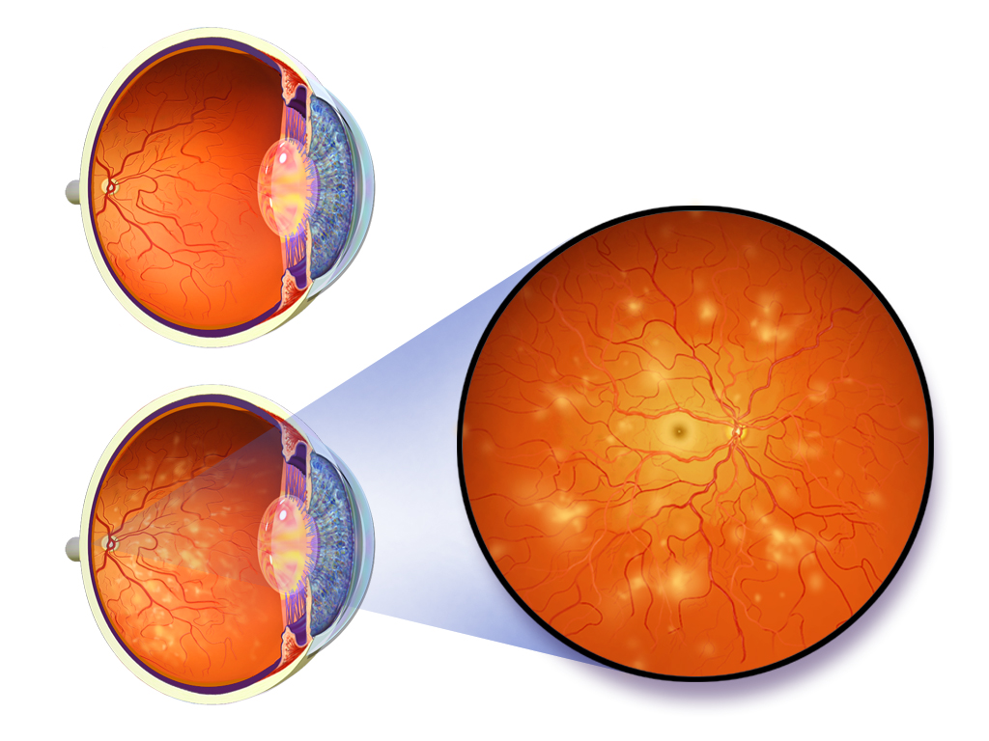
Sister project proposal

Slide 26
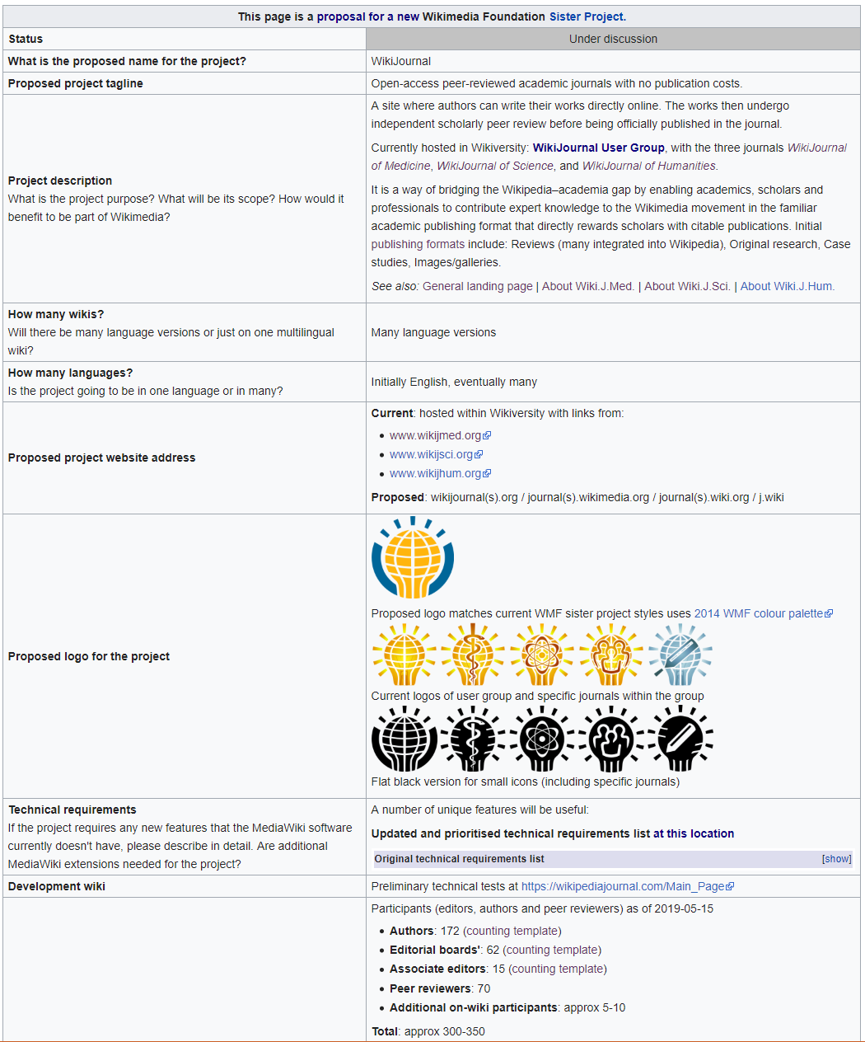
Sister Project
https://meta.wikimedia.org/wiki/WikiJournal
Currently hosted in Wikiversity
Sister project would allow for journal-specific features
Comment/support/oppose

Slide 27
Wikimedia journal hosting platform
Wikipedia Sister project
In whole
WikiJournals
PLOS Genetics
Host
Format
Example
One-off
examples in negotiation
In part
Features
Free interface for formatting articles ready for Wikipedia
Expert editors who give free advice and assistance
Specialist tools for facilitating the process

Slide 28
Wikimedia journal hosting platform
Site identity and branding
journals.wikimedia.org / wikijournals.org / journals.wiki / j.wiki
Specialised sidebar items and logos
CC BY default license
Automation of repetitive tasks
Assigning DOIs
Copying accepted articles into latest volume & issue
Formatting PDFs
Specialised extensions
Annotating history to mark version as published
Automated email reminders to reviewers
Wikidata integration to track peer reviews submitted to talkpages
Features

Slide 29
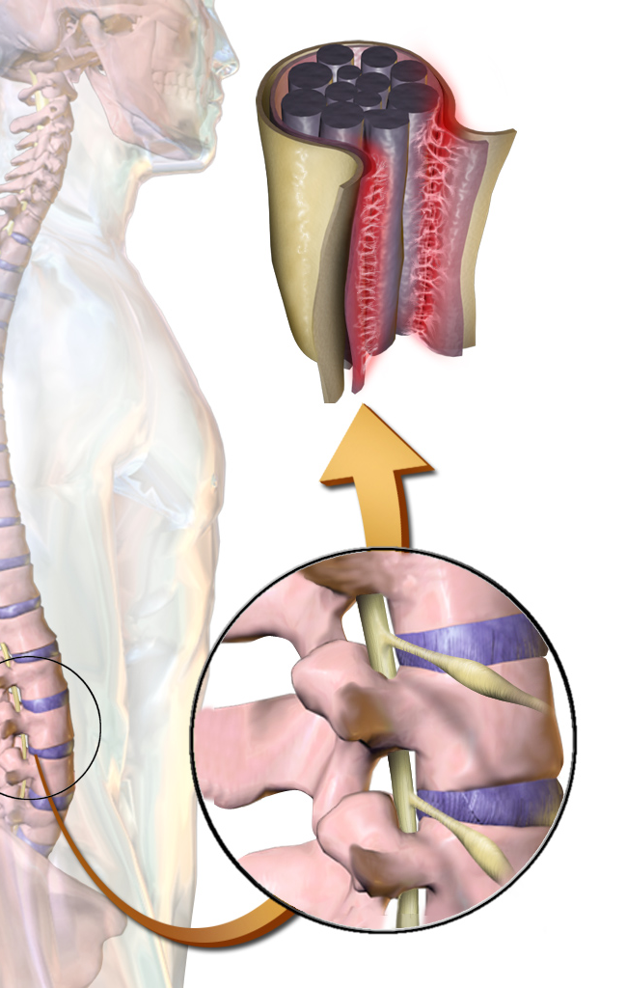
Possible one-off partnership system
One-off partnering with established subject-specialist journals that do not want to commit to ongoing wiki-integrated format
Specialist journal: Invite authors, identify peer reviewers
WikiJournal: Advise on wikipedia policy compliance, readability, style and formatting
Resulting article co-published in specialist journal & in a WikiJournal
Example article co-published by two journals:
Staniszewska, S., et al. (2017). GRIPP2 reporting checklists: tools to improve reporting of patient and public involvement in research. Research involvement and engagement, 3(1), 13
Staniszewska, S., et al. (2017). GRIPP2 reporting checklists: tools to improve reporting of patient and public involvement in research. British Medical Journal 358(1), j3453
Content then copied into Wikipedia per ‘journal-first’ model

Slide 30
Contribute
Publish an article. Credentials are not necessary.
Peer reviewing of article submissions. Does require expertise in the subject at hand.
Help preparing submitted articles
Join the editorial board and share your ideas about journal management
Currently looking for a treasurer
www.wikijmed.org
Notes:
Microsoft Engineering Excellence
Microsoft Confidential
30
Any questions?
…
Here is the journal address again, where there are also links to mentions of the journal in the news. You can also follow what’s going on at Facebook and Twitter.
Thank you!

Slide 31
www.WikiJMed.org
Submit an article
Peer review a submission in your field of expertise
Help preparing submitted articles
Join the editorial board and shape journal strategy
Currently looking for a treasurer
Contact@WikiJMed.org
WikiJMed
WikiJMed

Slide 32
[Additional extra slides]

Slide 33
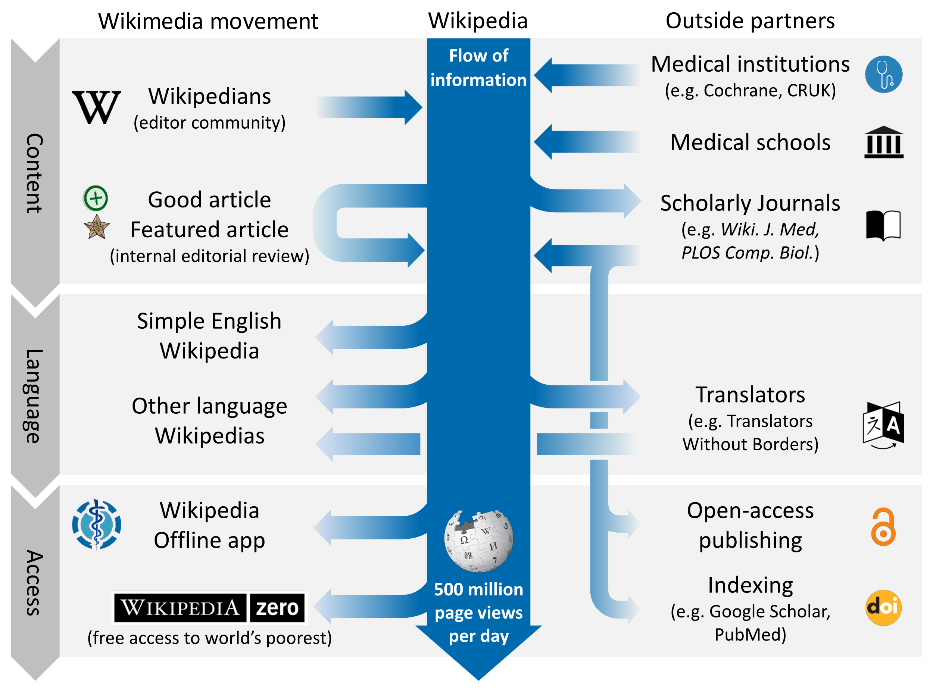
Shafee, T. et al. (2017). Evolution of Wikipedia’s medical content: past, present and future. JECH. 71(10)
Notes:
Also competitions for most improved article (e.g. Comp boil, WikiJMed)

Slide 34
Similarities and differences
 | Academic Journal | Wikipedia
Readership size | Small and brief Median article - 800 total Top 5% article - 3000 total | Very large and extended Median article - 10,000 per year Top 5% article - 1,000,000 per year
Readership composition | Other academics, often within narrow field | General public as well as experts and professionals
Peer review | Pre-publication, private review by 2-4 subject specialists | Post-publication public review of a sort by subject generalists ‘Good article’ - 1 reviewer ‘Featured Article’ - 5-12 reviewers
Reputation | Varies by journal but generally extremely high | Public generally trust Academics have mixed opinions but improving
Authorship | Small number with relevant, accredited expertise. Organised group with lead and corresponding authors. | Large number with mixed expertise levels. Loose organisation. Many pseudonymous or anonymous.
Timeliness | Static Updated by new publications | Constantly updated Only one consensus version
Shafee, T. et al. (2017). Evolution of Wikipedia’s medical content: past, present and future. JECH. 71(10)

Slide 35
Dfgsdfg
Sdfg
Sdg

