Slide 1
Wikipedia-integrated publishing
Dr Thomas Shafee
A comparison of successful models
Notes:
Average 1.5 min per slide → 50 mins
Best to maximise time on interactive section

Slide 2





My background
Evolvability of a Viral Protease
Experimental Evolution of Catalysis, Robustness and Evolvability
PhD
Username: Evolution and evolvability
16000 edits
  Specialist topics (e.g Catalytic triad)
  Broad topics (e.g. Enzyme, Gene)
  Created new (e.g Sequence space)
120 images
Editor for PLOS Genetics and WikiJournal of Medicine
Cambridge
Novel sequence-analysis techniques for small, cysteine-rich antimicrobial proteins
Understand their evolution to engineer their function
Wikpdeian
PostDoc
LIMS
Images: Cruccone (Wikimedia commons), LIMS website
Notes:
Edits across hundreds of pages.
Broad articles get million hits per year
Specialist still get 10s of thousands

Slide 3
Outline
Where do people find health information online?
A case study in the most-used source
Integrating academic publishing
Website traffic
Search behaviours
Who reads it
Who writes it
Dual-publication models that produce academic and public resources

Slide 4
Do people really look online for health information?
For many, it’s their primary information source
Notes:
Radio, Television, Podcasts, Social media, Internet, Doctors

Slide 5
Use of the internet for medical info
72% of internet users report having looked online for health information within the past year.
  77% began at a search engine (e.g. Google, Bing)
  13% began at a specialized health information site (e.g. wedMD.com)
25% hit a paywall during their searches
  2% pay up
  13% give up
  83% move on elsewhere
53% state that it influenced their decision
35% did not follow up their searches by visiting a clinician
NO
YES
Fox, S; Duggan, M. (2013). Health online. Pew Research

Slide 6
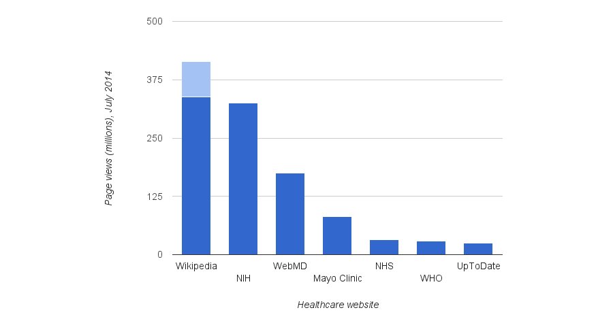
Competing sources of medical information
Of the many competing sources, most are non-commercial
Wikipedia’s med content dominates most search engine results
Heilman, J.M. and West, A.G., 2015. Wikipedia and medicine: quantifying readership, editors, and the significance of natural language. Journal of medical Internet research, 17(3), p.e62.
Notes:
Good news is mostly non-commercial (some advert, some subscription)
Wikipedia overall readership approx 100 billion per year

Slide 7
Wikipedia
A key tool in global public health promotion

Slide 8
A brief history
2001 began
2007 editing peak
  But poor accuracy
  Stricter standards lead to fall-off in editors
2015 resurgence
  Concerted recruitment
  Easier editing tools
  First year since 2007 with editor growth
In 288 languages
5th busiest website
Articles
Stricter standards
Recruitment
Easier editing tools
Active editors*
* >100 edits per month
Data: http://stats.wikimedia.org/EN/TablesWikipediaEN.htm
Notes:
2007 lowest average quality and highest reversion rate

Slide 9
Who reads Wikipedia?
Thesis
1-10
Median Wikipedia page
10,000 pa
Median Journal Paper
800
Top 5% Journal Paper
3,000
Top 5% Wikipedia page
1,000,000 pa

Slide 10




Who reads Wikipedia’s medical content?
General
public
Medical students
Practicing doctors
Research scientists
Fox S, Jones S. Pew Internet. 2009 | Hughes B, Joshi I, Lemonde H, Wareham J. Int J Med Inform 2009 Oct;78(10):645-655 | Allahwala UK, Nadkarni A, Sebaratnam DF. Med Teach 2013 Apr;35(4):337 | Nutzung von Social-Media-Diensten in der Wissenschaft 2017 Goportis – Leibniz-Bibliotheksverbund
Notes:
Also 87% of teachers
Also 35% of pharmacists
Policymakers and Journalists
Lawmakers have cited Wikipedia in >400 judicial decisions

Slide 11
Who reads Wikipedia’s other languages?
Wikipedia Zero provides free internet access to Wikipedia
  53 counties, 309 million
  For many people, Wikipedia+Facebook is their only knowledge of the internet
Odia language
  Spoken by 36.6 million people
  Wikipedia is the only source of medical information in that language on most topics
Ebola outbreak of 2014
  Relevant Wikipedia pages rapidly translated to 128 languages, including:
  Afrikaans; Akan; Amharic; Bambara; Chichewa/Nyanja; Ewe; Fula; Hausa; Igbo; Kikuyu (Gikuyu); Kinyarwanda; Kirundi; Luganda; Oromo; Sesotho; Sesotho sa Leboa (N. Sotho); Setswana; Shona; Swahili; Swazi; Tigrinya; Tsonga; Venda; Xhosa; Yoruba; Zulu

Slide 12
Who writes Wikipedia?
Admins & Bureaucrats (600 active)
  Peer exam and interview
  Can mark pages as protected and block editors
  Some niche privileges (e.g. delete pages, allow editing bots)
Editors (30,000 active)
  Access to Visual Editor
  Persistent reputation
  Able to edit protected pages
Anonymous users (⅓ of all edits)
  Text recognition test to prove human
  Edits are marked with ip address
  Can edit >99% of pages
Data: http://stats.wikimedia.org/EN/TablesWikipediaEN.htm ; http://stats.wikimedia.org/EN/EditsRevertsEN.htm ; https://en.wikipedia.org/w/index.php?title=Wikipedia:List_of_administrators/Active&action=history
Notes:
Whole systems runs as microdemocratic anarcho-beurocracy but is not purely any of these

Slide 13

Who writes Wikipedia’s medical content?
WikiProject Medicine
Main community for medical editors
One of the most established and active communities
130 participants active on its discussion forum in any given 90-day window
A further 700 editors who edit articles within its scope
30,000 medical articles

Slide 14


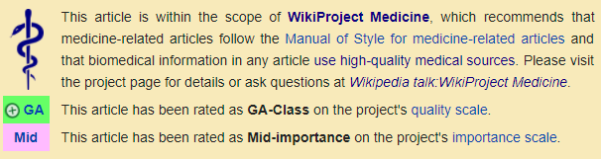
Article quality: internal review
Articles are rated
  Importance
  Quality
Top two quality ratings
  Promoted by review
  Status can also be revoked by review
Status
  Displayed on talk page
Pseudo peer-reviewed
https://en.wikipedia.org/wiki/Wikipedia:Version_1.0_Editorial_Team/Medicine_articles_by_quality_statistics

Slide 15
Article quality: medical topics
Wikipedia’s internal review standards:
  Medical content is better than average
  Still much to be done
Errors
  Misinformation rare Omission common
Improvement
  Small contributor pool does most work
Number of articles
Number of articles
Importance rating
Shafee, T; Masukume, G; Kipersztok, L; Das, D; Häggström, M; Heilman, J. (2017). “The evolution of Wikipedia’s medical content: past, present and future“. Journal of Epidemiology and Community Health. 71 (10).

Slide 16
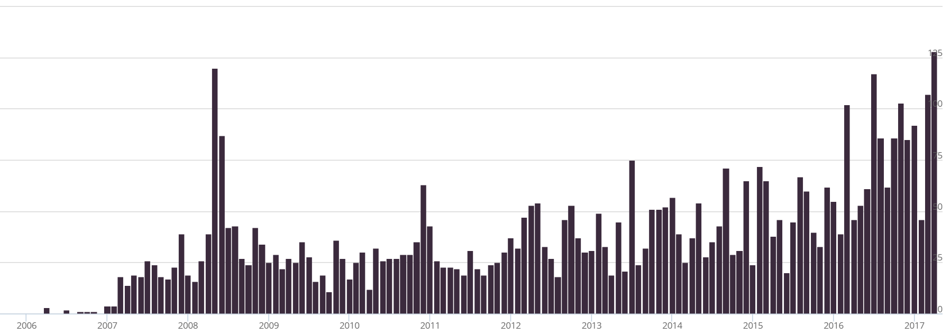
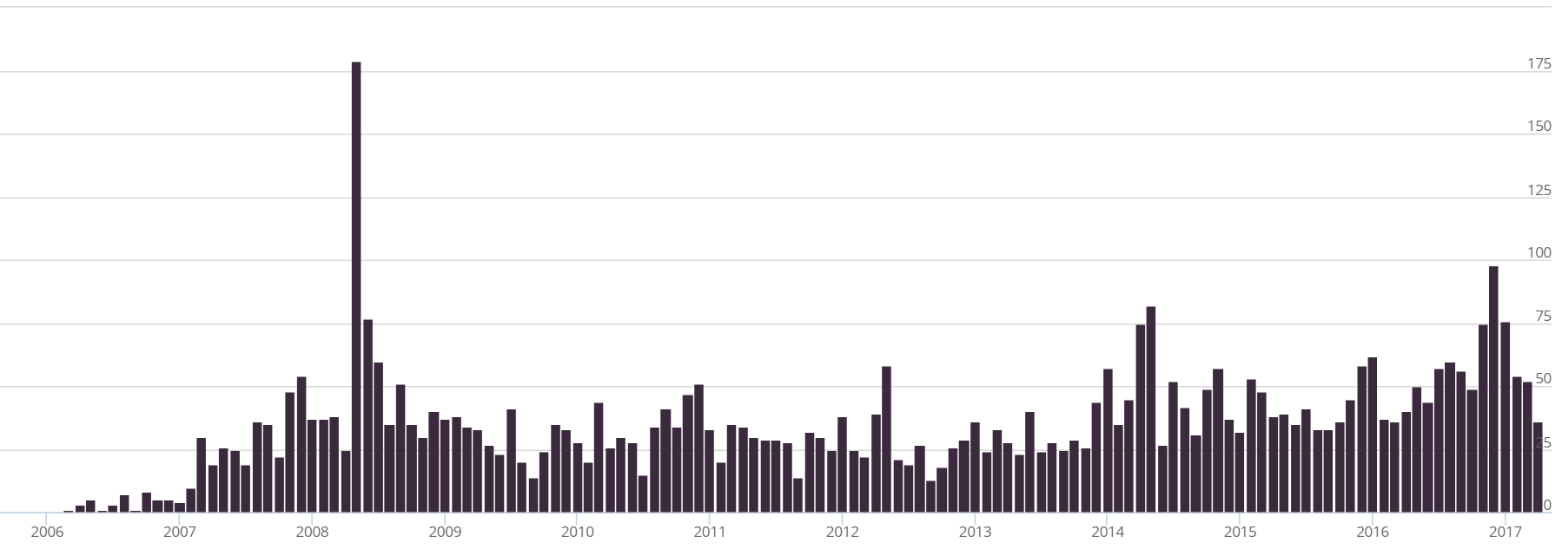
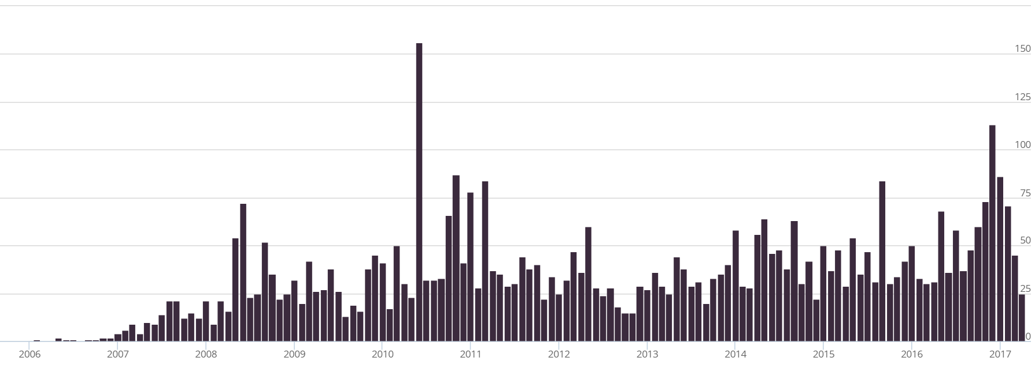
Article quality: referencing
Higher-quality articles have more references (no great surprise)
Hundreds of references added to the encyclopedia per month
100
0
Lancet
Citations added to Wikipedia per month
100
NEJM
0
100
0
BMJ
2006
2008
2010
2012
2014
2016
Year
Shafee, T; Masukume, G; Kipersztok, L; Das, D; Häggström, M; Heilman, J. (2017). “The evolution of Wikipedia’s medical content: past, present and future“. Journal of Epidemiology and Community Health. 71 (10).

Slide 17
Article quality: external review
Quality comparable to encyclopedia Britannica even back in 2005
Accuracy varies by topic, but broad trends:
  Inconsistent coverage
  Missing / out of date information
  Missing illustration
  Difficult readability
Accuracy has immediate, real-world impact
  Internet medical data influences the healthcare decisions of >50% of readers
  Many articles are read a million times per year
Yet is has been consistently difficult to engage academics, experts and health professionals
Nature 2005 438:900 | S Fox, M Duggan Pew internet 2013

Slide 18
How can experts be encouraged to contribute?
Making an immediate, real-world impact

Slide 19
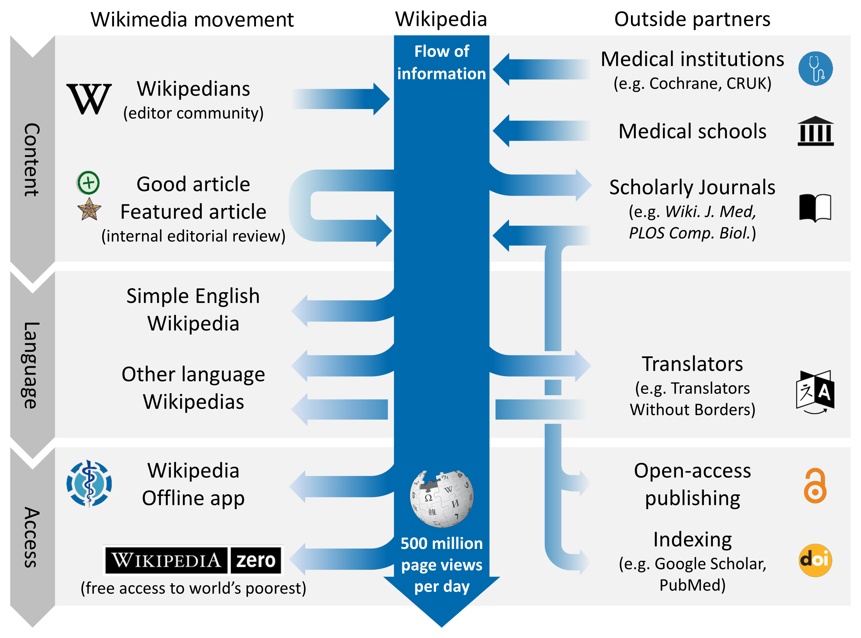
Shafee, T; Masukume, G; Kipersztok, L; Das, D; Häggström, M; Heilman, J. (2017). “The evolution of Wikipedia’s medical content: past, present and future“. Journal of Epidemiology and Community Health. 71 (10).
Notes:
Also competitions for most improved article (e.g. Comp boil, WikiJMed)

Slide 20


Dual-publishing Models
Content published into both Wikipedia and academic corpus
  Stable, citable, peer-reviewed version with the credibility of a scholarly journal
  Living version with extreme impact of Wikipedia
Journal first

Slide 21
Dual-publishing Models
Content published into both Wikipedia and academic corpus
  Stable, citable, peer-reviewed version with the credibility of a scholarly journal
  Living version with extreme impact of Wikipedia
Wikipedia first

Slide 22
Dual-publishing Models
Content published into both Wikipedia and academic corpus
  Stable, citable, peer-reviewed version with the credibility of a scholarly journal
  Living version with extreme impact of Wikipedia
Parallel

Slide 23

Journal first
Wikipedia used as secondary publishing outlet
License: CC-BY
Benefits
  Easily compatible with common publishing practices
  Editing Wikipedia is now as easy as editing a Word document
Limitations
  Wikipedia article must be absent or minimal to avoid conflict
Examples:
Volz, E; Koelle K; Bedford, T. (2013). Viral phylodynamics. PLoS Comput Biol, 9(3)
Ravenhall, M; Škunca, N; Lassalle, F; Dessimoz, C. (2015). Inferring horizontal gene transfer. PLoS Comput Biol, 11(5)
Lalchhandama, K. (2017). Plasmodium falciparum erythrocyte membrane protein 1. WikiJMed 4 (1): 4.
Notes:
But most pages under 500 words

Slide 24

Wikipedia first
Wikipedia used as preprint server
License: CC-BY-SA
Benefits
  Incentivises earlier update of Wikipedia
  Even relatively complete Wikipedia pages can be updated
  Compatible with multiple versions of review
Limitations
  Requires uncommon CC-BY-SA license
  Authors may be numerous and some even anonymous
Examples:
Wright, M; et al. (2017). The Hippocampus. WikiJMed 4 (1): 3.
Wright, M; Skaggs, W; Nielsen, F; et al. (2016). The Cerebellum. WikiJMed 3(1): 1.
Heilman, J; De Wolff, J; Beards, G; Basden B. (2014). Dengue fever: a Wikipedia clinical review. Open Medicine. 8 (4): 105–115
WikiJMed
Notes:
But various tools to summarise authorship as lists, or even colour coded text to define who did what

Slide 25


Parallel
Wikipedia used as lay summary
License: Any
+ CC-BY-SA
Benefits
  Journal and Wikipedia versions can be different length, depth or style
  Any Wikipedia article is applicable
Limitations
  More work for the author (if closed access, nothing can be reused)
  Often implemented by non-open access journals
  Less direct validation of the Wikipedia version
Examples:
Jones, T; Otto, W; Marz, M; Eddy, S; Stadler P. (2009). A survey of nematode SmY RNAs. RNA Biol. 6 (1): 5–8
Silveyra, S; Floros, J. (2013). Genetic complexity of the human surfactant-associated proteins SP-A1 and SP-A2". Gene. 531 (2): 126-32
Notes:
WikiJournal of Medicine “Encyclopedic” review articles

Slide 26
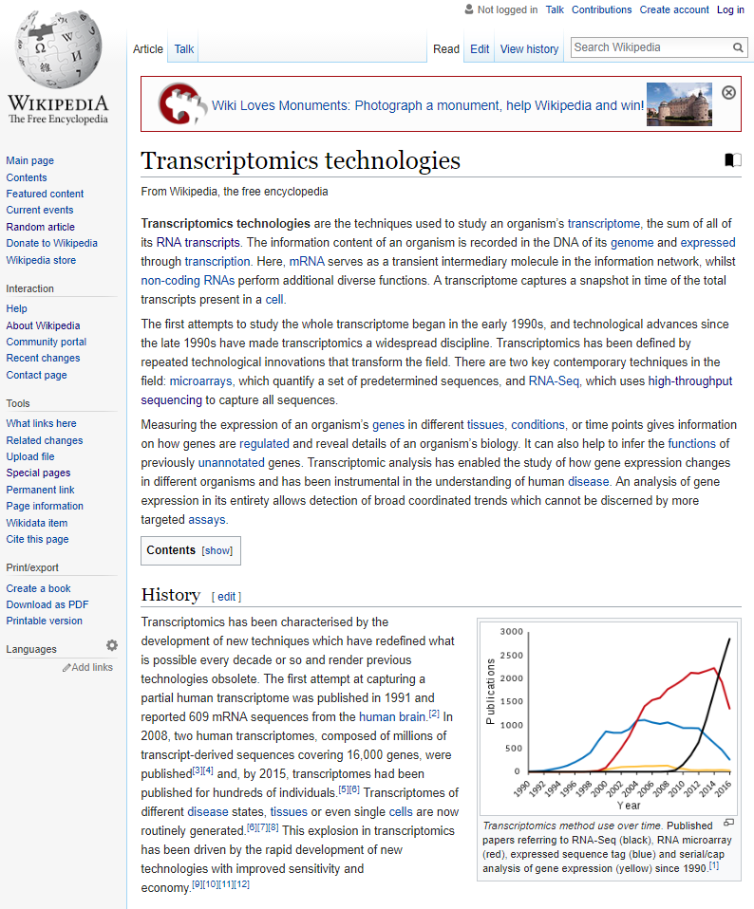

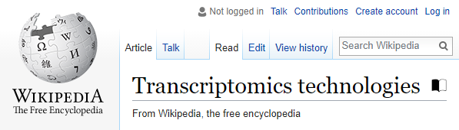

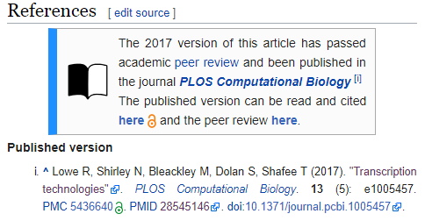
Links from the Wikipedia article
This article has been published in the peer-reviewed journal PLOS Computational Biology. Click to view the published version

Slide 27
Sooooo… who pays?
Reader subscription / author (e.g. Gene, RNA Biol)
  Typically charge subscription fees
  Article processing fee of $3300 and $2000 respectively
Journal waiver (e.g. PLOS)
  For Topic Page review articles, PLOS waives its usual $2250 APF
Charitable foundation (e.g. Wiki.J.Med.)
  Web hosting cost is covered by the Wikimedia Foundation
  Editors donate volunteer labour so no fees of any kind

Slide 28
What does the future hold?
And what should it?

Slide 29
+ British Medical journal
+ Other PLOS journals
+ Other WikiJournals
Shafee, T; Masukume, G; Kipersztok, L; Das, D; Häggström, M; Heilman, J. (2017). “The evolution of Wikipedia’s medical content: past, present and future“. Journal of Epidemiology and Community Health. 71 (10).
Notes:
Also competitions for most improved article (e.g. Comp boil, WikiJMed)

Slide 30




Some ways to encourage contribution
Individual
Societal
Encourage new editors to overcome activation energy to make their first edit
Deliberate recruitment to improve diversity (demographics, expertise, etc)
Editing Wikipedia needs to be seen as a valuable use of time
Formal recognition of contribution by professional bodies
Physical
Organisational
Continue advancement of tools and interface to make editing easier
Increase automation to assist editors
Encouraging institutions to support partnerships and collaborations
Consolidating Wikipedia’s policies to avoid putting off new users by early mistakes
Shafee, T; Masukume, G; Kipersztok, L; Das, D; Häggström, M; Heilman, J. (2017). “The evolution of Wikipedia’s medical content: past, present and future“. Journal of Epidemiology and Community Health. 71 (10).
Notes:
Probably best public engagement you’ll ever do (e.g. grant writing?)
If your topic is not covered, it can make your research look more obscure than it really is
If your paper is reviewed by a scientist outside your field what are the odds they’ll check Wikipedia?
Get PhDs and Postdocs involved.
Order of magnitude more views than highest review paper.

Slide 31
Contact
  Email Thomas.Shafee@gmail.com
  Google Scholar Thomas Shafee
  ResearchGate Thomas Shafee
  LinkedIn Thomas Shafee
Journals
  WikiJournal of Medicine (WikiJMed.org)
  PLOS (TopicPagesWiki.plos.org)
Wikipedia
  My userpage Search “User:Tshafee”
  WikiProject Medicine Search “WP:MED”
Shafee, T; Mietchen, D; Su, A. (2017). “Academics can help shape Wikipedia”. Science. 357 (6351): 557–558.
Shafee, T; Masukume, G; Kipersztok, L; Das, D; Häggström, M; Heilman, J. (2017). “The evolution of Wikipedia’s medical content: past, present and future“. JECH. 71 (10).
Shafee, T (2017) “Wikipedia-integrated publishing: A comparison of successful models”. Health Inform. (in prep)

Slide 32
Similarities and differences
Content, quality, collaboration

Slide 33
Similarities to scientific writing
Neutral point of view [[WP:NPOV]]
  Balanced information
Cite reliable, verifiable sources [[WP:RS]] [[WP:VER]]
Avoid plagiarism [[WP:PLAG]]
  Several detection bots search for instances
  Don’t accidentally copyvio yourself!
Short lead abstract [[WP:LEAD]]
Open-access mentality [[WP:FIVEPILLARS]]
Post-publication peer review (of a sort)
  Continuous editing and improvement by other authors
  Organised peer review for ‘Good Article’ or ‘Featured Article’ status [[WP:GA]] , [[WP:FA]]
https://en.wikipedia.org/wiki/User:CorenSearchBot
Notes:
You’re already well set up for good editing practice
Don’t put in 5 paragraphs on some obscure point on a page.
Probably more citations than typical introduction (No personal comms, or unpub data)

Slide 34
Differences to scientific writing
Content & format
Referencing & quality
Peers & collaboration

Slide 35

Differences (content & format)
General audience! [[WP:TECHNICAL]]
  Everything should be understandable to a undergraduate
  The first paragraph should be understandable to a secondary school pupil
  Wikilink to key relevant topics [[WP:LINK]]
Writing style [[WP:MOS]]
  No referencing images, they should stand alone
  Minimise name-dropping
  Date-relevant statements become out of date quickly
  Avoid review-style colloquialisms
See figure 5
Jones et.al. have demonstrated that...
In this article we focus on examples from proteases…
Currently / the newest / recent…

Slide 36
Differences (references & quality)
Secondary sources are preferred [[WP:SCIRS]] , [[WP:MEDRS]]
  Open online preference
  Especially for medical statements
No original research [[WP:NOR]]
  Including synthesis of information
  Can only summarise published work
Constantly updating work-in-progress [[WP:WIP]]
Different grades Stub – Start – C – B – A – Good – Featured [[WP:ASSESS]]
Active site mutations inactivate enzymes.[1][2][3][4][5][6][7][8][9][10]
CRISPR-cas9 can be used to edit mammalian genomes.^{[1][2][3][4][5][6]}
Together, these data indicate…
Notes:
Referenceing and quality
Not just published or not. Can go up (and down) over time

Slide 37
Differences (peers & collaboration)
No ownership [[WP:OWN]]
  There’s no official lead or corresponding author
Everyone’s equal [[WP:FIVEPILLARS]] , [[WP:BE BOLD]]
  You may sometimes need to explain your edits to people with less knowledge then you
  Editors don’t have to be experts on the topic or on Wikipedia editing
  The average edit is more helpful than harmful
Notability [[WP:NOTE]]
  Academic biographies must be particularly so [[WP:PROF]]
Disagreements [[WP:DISPUTE]]
  Article’s talk page
  Dispute resolution mediation request [[WP:DRR]]
Notes:
And you will certainly all be better than average editors so don’t worry about breaking things. People will catch your mistakes.
You own nothing.
Resolution either by one-off third opinion, formal

Slide 38

Further help
Interactive help (scarily fast response times)
  Teahouse for new editors [[WP:TH]]
  Helpdesk for experienced editors [[WP:HD]]
Tutorials
  General tutorial [[Help:Intro_to]]
Scientist-specific advice
  Ten simple rules for editing Wikipedia - Logan et. al. (2010) Plos Comp. Bio.

